Slide 1
Prouster
V 0.2
Galvanize Data Science Immersive
Summer 2018

Slide 2

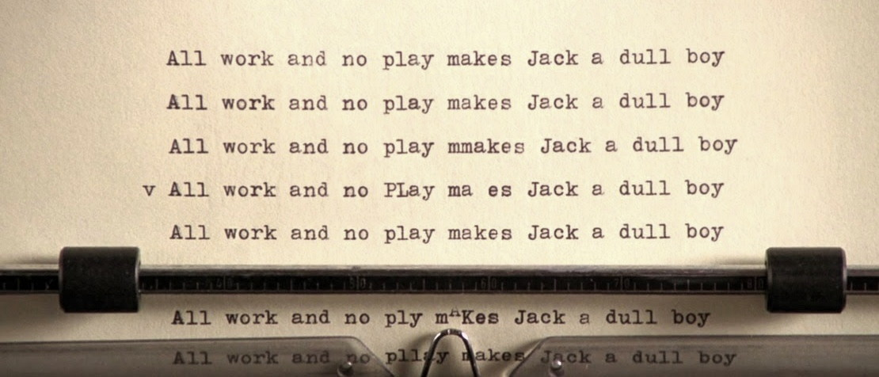
The Problem!
Creative Block
Definition: A period of time when ideas and creative thinking seem to run dry.
A problem with many faces:
Technology: Impaired ability to think out-of-the-box to deliver solutions.
Artists: Lack of inspiration to produce new material.
Individuals: Depression & Anxiety, Demotivation

Slide 3
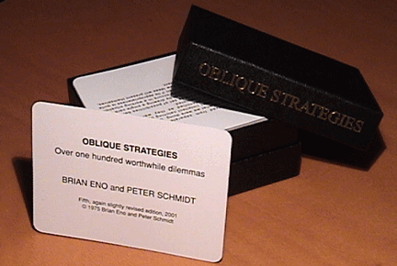
Prousting the Problem!
Introducing Prouster
An interactive Neural Network interface that generates writing prompts.
Project Inspirations:
Named after Marcel Proust, creator of the Proust Questionnaire
Oblique Strategies by Brian Eno & Peter Schmidt
Sunspring - Short film written by AI

Slide 4
Potential Use Cases:
Interactive Brainstorming
Writing Contests
Improvised Response
English Teaching
Beneficial to Mental Health

Slide 5
Functionality
Keras Recurrent Neural Networks:
Char-level model:
Slower
Prone to misspelling.
Word-level model:
Faster (but requires more data)
Prone to grammar/punctuation issues.

Slide 6
Data Inputs
Sources:
Writing Prompts from Reddit
https://www.reddit.com/r/datasets/comments/8z1g24/rwritingprompts_dataset_for_language_models/
Oblique Strategies
https://github.com/tomgp/Oblique-Strategies/tree/master/data
Tags:
WP - General Writing Prompt
OS - Oblique Strategies
CW - Constrained Writing Example: Write without using pronouns.
TT - Theme Thursday Example: Detective Stories
EU - Established Universe Example: Harry Potter

Slide 7
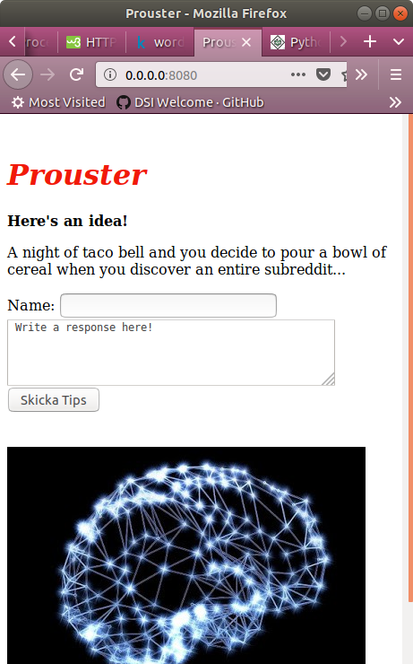
Website Demo
Application of rNN .py file output into HTML environment
Additional Functionality:
Name Query for a user profile.
NLTK Sentiment Analysis based on user response.
Add filter for undesired words.

Slide 8
Future Steps
Sentiment Analysis on User Output
Prettify website (Possible JS/CSS)
Test predictive power of Recurrent Neural Network on different dataset(s)

Slide 9
Author: Jared Anderson
https://www.linkedin.com/in/jared-bonjean-anderson/
https://github.com/ander265

